Slide 1

Employee Mental-health Risk Stratification
Using Machine Learning
______
An Exploratory Survey-Based Screening Framework
_________________________________________________
CAPSTONE PROJECT
Betsy Varghese
PGA38 | Capstone Project 1
August 2026
Notes:
Introduce the project as exploratory survey-risk stratification rather than depression or anxiety diagnosis.
[Sources]
- User-supplied notebook: CP_1_on_Survey_Data_Risk_Stratification_PGA38_Betsy Varghese(3).ipynb, title and project scope
- User-supplied presentation: Survey_Risk_Stratification.pptx

Slide 2
Problem Statement & Research Objectives
Building a trustworthy model begins with solving the right problem and preventing data leakage
PROBLEM STATEMENT
________________
WHY LEAKAGE PREVENTION MATTERS
________________
Build a screening tool that classifies tech-industry employees into Low- and High-risk groups based on their mental health.
Compare ten machine-learning models (baseline -Logistic Regression, SVM, KNN, Naive Bayes, MLP and ensemble - Random Forest, Extra Trees, AdaBoost, Gradient Boosting, XGBoost) using macro-F1, while tracking High-risk recall.
The purpose is not a clinical diagnosis, but to surface cases needing closer human review on timely basis
The four variables used to engineer the target variable - work_interfere, family_history, treatment and obs_consequence - are excluded from the predictors
Keeping them would reveal the answer to the model, inflate validation scores and reduce trust on unseen data.
Timestamp, comments, state and Gender are also excluded because they add limited modeling value, are unstructured or highly incomplete.
Leakage prevention is essential for unbiased and trustworthy performance on unseen respondents.
Survey Responses
Leakage-Free Dataset
Machine Learning Model
Notes:
Emphasize that leakage prevention is required for believable performance on unseen respondents.
[Sources]
- User-supplied notebook: CP_1_on_Survey_Data_Risk_Stratification_PGA38_Betsy Varghese(3).ipynb, Cells 16 and 38
- User-supplied presentation: Survey_Risk_Stratification.pptx

Slide 3
Leakage-safe dataset design
From 27 raw columns to 20 independent, leakage-safe model features.
1,259
Responses
27
Raw Columns
20
Model Features
THE 27 20 FEATURE TRANSITION
DATASET SNAPSHOT
NOTE ON STATE
The raw survey contains 27 columns. Four target-source variables are removed to prevent leakage, along with three additional columns with limited modelling value or high missingness
RAW | 27 columns
FEATURES | 20 leakage-safe predictors
NUMERIC | Age
CAT. | Workplace policies, attitudes and demographics
MISSING | comments: 87.0% | state: 40.9% | work_interfere: 21.0%
AGE | Valid observed range retained: 18–72
TARGET | Low vs High engineered survey risk
TASK | Binary classification with interpretability
The “state” column is almost entirely US-specific among non-missing entries, but not exclusively:
REMOVED TO PREVENT LEAKAGE (4)
work_interfere
family_history
treatment
obs_consequence
740
US entries
REMOVED FOR MODELING REASONS (3)
timestamp
comments
4
Non-US entries
state
gender
Result: 20 leakage-safe predictors used for modelling
Notes:
Explain the 27-to-20 feature transition. State is almost entirely US-specific among non-missing entries, but not exclusively: 740 US and four non-US entries.
[Sources]
- User-supplied notebook: CP_1_on_Survey_Data_Risk_Stratification_PGA38_Betsy Varghese(3).ipynb, Cells 22, 23 and 38
- User-supplied presentation: Survey_Risk_Stratification.pptx

Slide 4
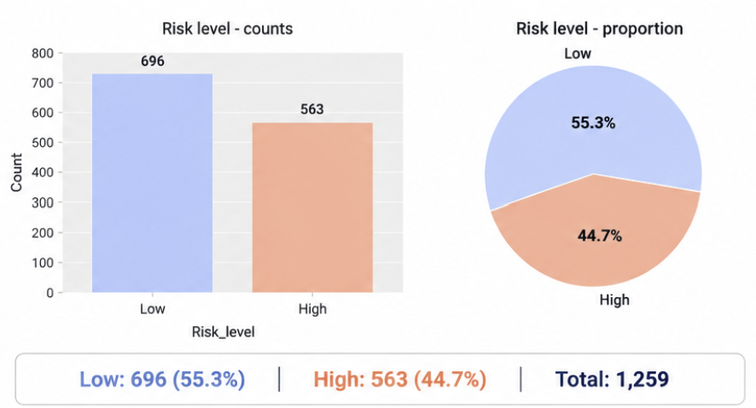
Engineering the risk target
A high-risk label is engineered from four confidential survey variables.
1. TARGET ENGINEERING LOGIC
3. ENGINEERED RISK LEVEL DISTRIBUTION
Risk_score = 2 x work_interfere + family_history + treatment + obs_consequence
Each variable is coded as 0 = No, 1 = Yes
A higher score indicates higher underlying risk
Median split of the risk_score is used to create the binary target
All four target-source columns
2. THE FOUR CONFIDENTIAL VARIABLES
Variable | What it Captures
work_interfere | Interference with work
family_history | Family history of mental health
treatment | Currently in or seeking treatment
obs_consequence | Observed consequence of mental health
4. TARGET DEFINITION
High-Risk (1) | Respondents with a risk_score greater than or equal to the medians (derived from the four variables).
Low-Risk (0) | Respondents with a risk_score less than the median.
PURPOSE: | The engineered target enables the identification of employees at higher risk for mental health challenges to support human review and awareness, not clinical diagnosis
Notes:
Work interference receives double weight as the direct functional-impact signal. Missing source values are treated as zero, which is an explicit assumption and limitation.
[Sources]
- User-supplied notebook: CP_1_on_Survey_Data_Risk_Stratification_PGA38_Betsy Varghese(3).ipynb, Cells 16 and 32
- User-supplied presentation: Survey_Risk_Stratification.pptx

Slide 5
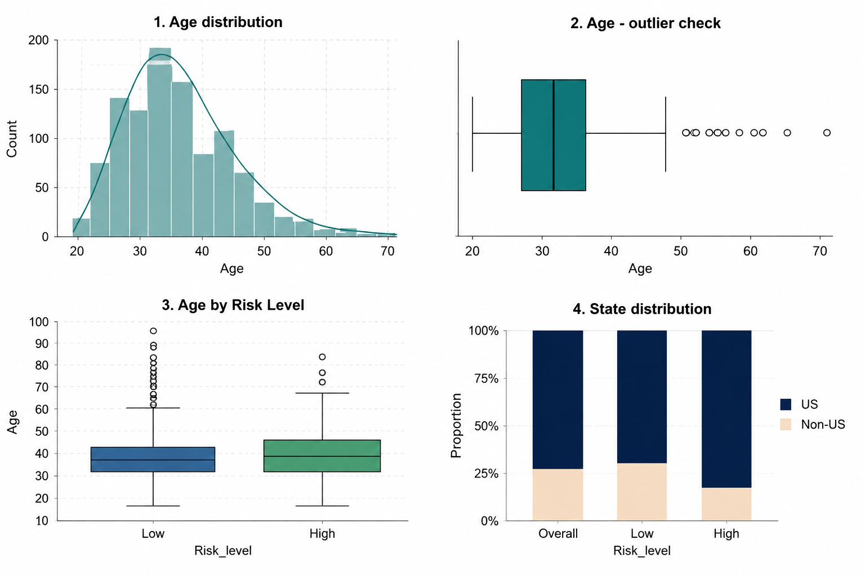

Initial cleaning, EDA and Leakage-safe pre-processing
Age values outside 18-100 are converted to missing; the observed valid range is 18-72.
Gender had 40+ variants which was cleaned to 3.
After the split, age is median-imputed and standardized.
Categorical variables are mode-imputed and one-hot encoded.
OneHotEncoder(handle_unknown=‘ignore’,min_frequency=10) handles unseen and rare categories safely inside each training fold.
LEAKAGE GUARD:
Work_interfere, family_history, treatment and obs_consequence never enter X
Notes:
Imputation, scaling and encoding are fitted inside training folds through the Pipeline; this prevents preprocessing leakage.
[Sources]
- User-supplied notebook: CP_1_on_Survey_Data_Risk_Stratification_PGA38_Betsy Varghese(3).ipynb, Cells 13, 26, 34, 35, 38 and 42
- User-supplied presentation: Survey_Risk_Stratification.pptx

Slide 6
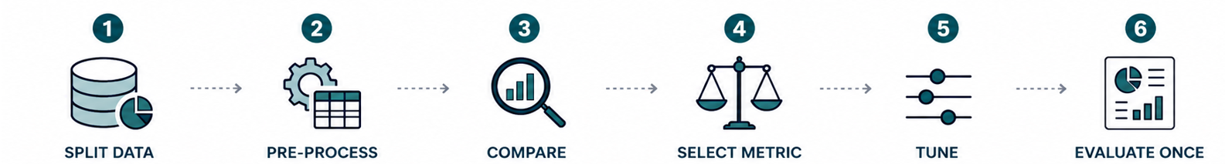

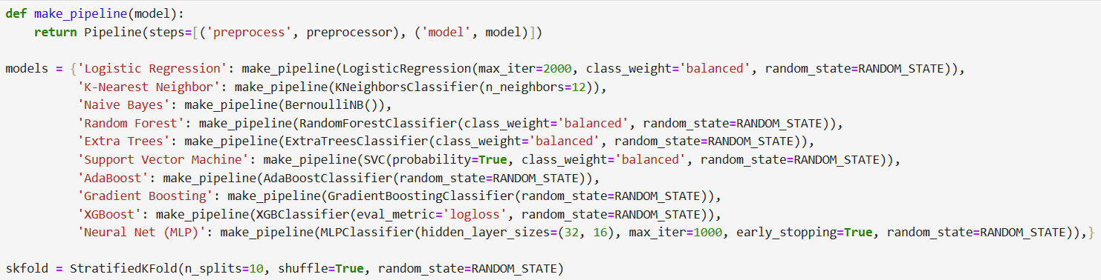
Modeling workflow
80% train/ 20% test, Stratified (1,007/252)
ColumnTransformer inside sklearn.Pipeline
10 models with 10-fold StratifiedKFold
Macro-F1 gives both classes equal weight
GridSearchCV on training folds only
Classification report, confusion matrix and ROC-AUC
CODE PATTERN: Pipeline([('preprocess', preprocessor), ('model', model)])
Notes:
The test set remains untouched until Extra Trees has been selected from cross-validation.
[Sources]
- User-supplied notebook: CP_1_on_Survey_Data_Risk_Stratification_PGA38_Betsy Varghese(3).ipynb, Cells 40, 42, 44–63
- User-supplied presentation: Survey_Risk_Stratification.pptx

Slide 7

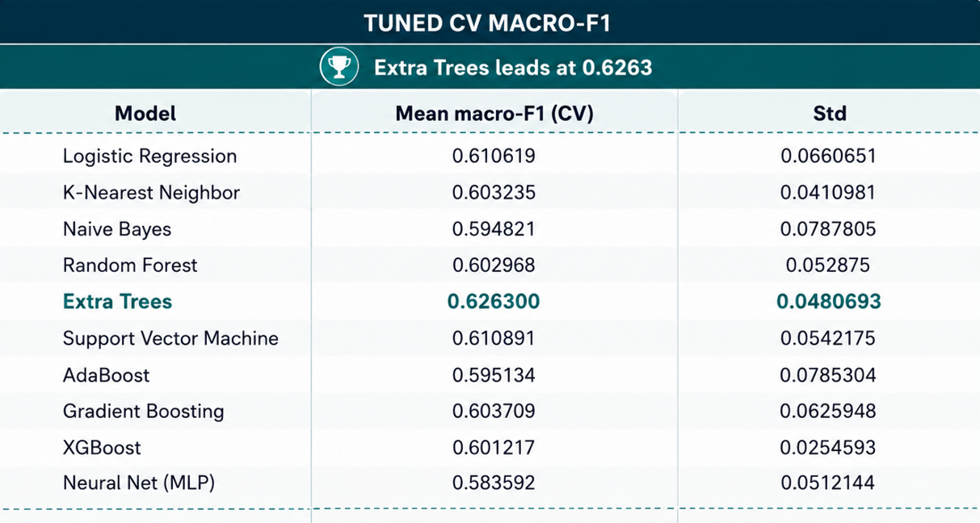
Modeling comparison
Tuned 10-fold cross-validation macro-F1 scores on the training set. Extra Trees ranks first at 0.6263, narrowly ahead of Random Forest at 0.6261; the untouched test set is not used for model selection.
Notes:
The two leading tree ensembles are effectively tied; Extra Trees wins by approximately 0.0001 macro-F1.
[Sources]
- User-supplied notebook: CP_1_on_Survey_Data_Risk_Stratification_PGA38_Betsy Varghese(3).ipynb, Cells 50–63
- User-supplied presentation: Survey_Risk_Stratification.pptx

Slide 8
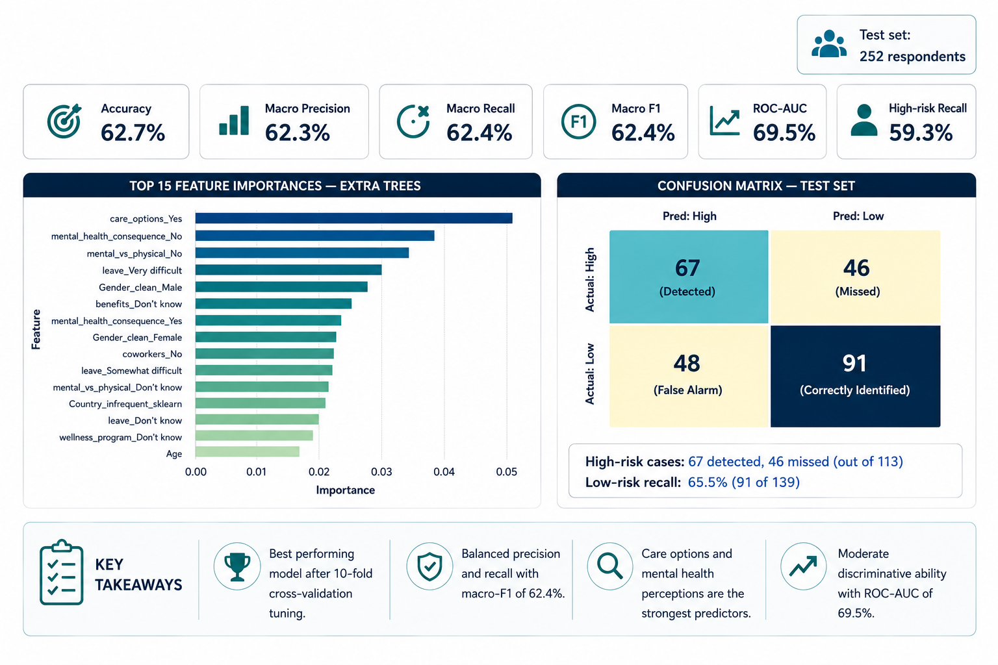
Best model results – extra trees
Notes:
The confusion matrix detects 67 of 113 High-risk respondents and misses 46. The feature-importance image is from tuned Random Forest, as coded in the notebook, not from the selected Extra Trees model.
[Sources]
- User-supplied notebook: CP_1_on_Survey_Data_Risk_Stratification_PGA38_Betsy Varghese(3).ipynb, Cells 65–73
- User-supplied presentation: Survey_Risk_Stratification.pptx

Slide 9
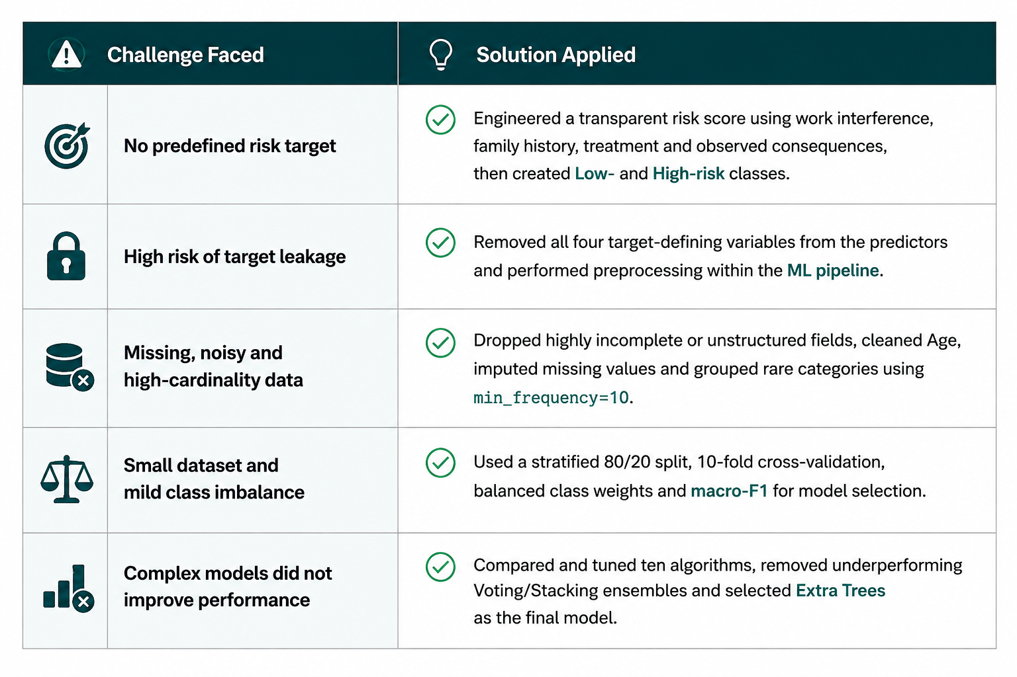
Project challenges and how they were addressed
Notes:
Close with the distinction between an exploratory screening signal and a clinically validated tool.
[Sources]
- User-supplied notebook: CP_1_on_Survey_Data_Risk_Stratification_PGA38_Betsy Varghese(3).ipynb, Cells 63–73
- User-supplied presentation: Survey_Risk_Stratification.pptx

Slide 10




Conclusion
Proposed Solution
The project converts an unlabelled survey into a reproducible binary-classification task while explicitly blocking target leakage.
Best Model Performance
Across ten tuned algorithms, Extra Trees achieved the best validation result (Macro-F1 = 0.6263). On the untouched 252-person test set: 62.7% accuracy, 62.3% macro precision, 62.4% Macro-F1, 59.3% High-risk recall, and 69.5% ROC-AUC.
Interpretation
The results indicate moderate screening capability rather than diagnostic performance. The Extra Trees feature importance plot serves as an interpretability aid by highlighting the workplace factors that contributed most to the model's predictions. These feature importance scores represent predictive associations, not causal or clinical relationships.
Key Findings
Workplace-related factors, particularly care options, mental health consequences, and perceptions of mental versus physical health, consistently emerged as the strongest predictors of employee mental health risk.
Notes:
Close with the distinction between an exploratory screening signal and a clinically validated tool.
[Sources]
- User-supplied notebook: CP_1_on_Survey_Data_Risk_Stratification_PGA38_Betsy Varghese(3).ipynb, Cells 63–73
- User-supplied presentation: Survey_Risk_Stratification.pptx

